Slide 1
Chi-Square Analyses
More appropriately called: Nominal Data Tests

Slide 2
A reminder
Parametric statistics: ANOVA, t, regression – used when the dependent variable is continuous
Non-parametric statistics: chi-square, proportion tests, log regression – used with the dependent variable is not continuous (i.e. ordinal or nominal)

Slide 3
Chi-Square Tests
Chi-square
One Variable
Proportion Test
Goodness of fit
Two Variables
Independence
Fisher's
McNemar's
Focus on the number of people in different categories

Slide 4
Chi-Square Tests
One variable tests:
Proportion test – identifies if two independent proportions are different
McNemar’s proportion test – identifies if two dependent proportions are different
In theory, proportion tests can also be considered two variable chi-squares.

Slide 5
Chi-Square
Observed frequency – number of individuals actually found in the study to be in a cell
Expected frequency – number of individuals in a category or cell expected if the null is true

Slide 6
Chi-Square Tests
One variable tests:
Goodness of fit test - how well an observed frequency distribution of a nominal variable fits some expected frequency pattern for a single variable.

Slide 7
Chi-Square Tests
Two variable tests:
Independence test – tests to see if distribution of frequencies of one variable is related to the distribution of another variable.
This test is for independent data only.

Slide 8
Chi-Square Tests
Two variable tests:
Fisher’s Exact Test – tests to see if distribution of frequencies of one variable is related to the distribution of another variable.
This test is for independent data only.
How is this one different than independence?
Chi-square uses an approximation for p
Fisher’s exact calculates exact p
Which is better?

Slide 9
Chi-Square Tests
Two variable tests:
McNemar’s Test – tests to see if distribution of frequencies of one variable is related to the distribution of another variable.
This test is for dependent data only.
Often used as dependent proportion test.

Slide 10
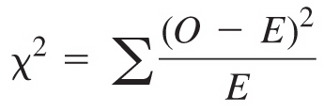
Chi-Square Statistic
Observed frequency distribution
Expected frequency distribution
Chi-square statistic (χ²)

Slide 11
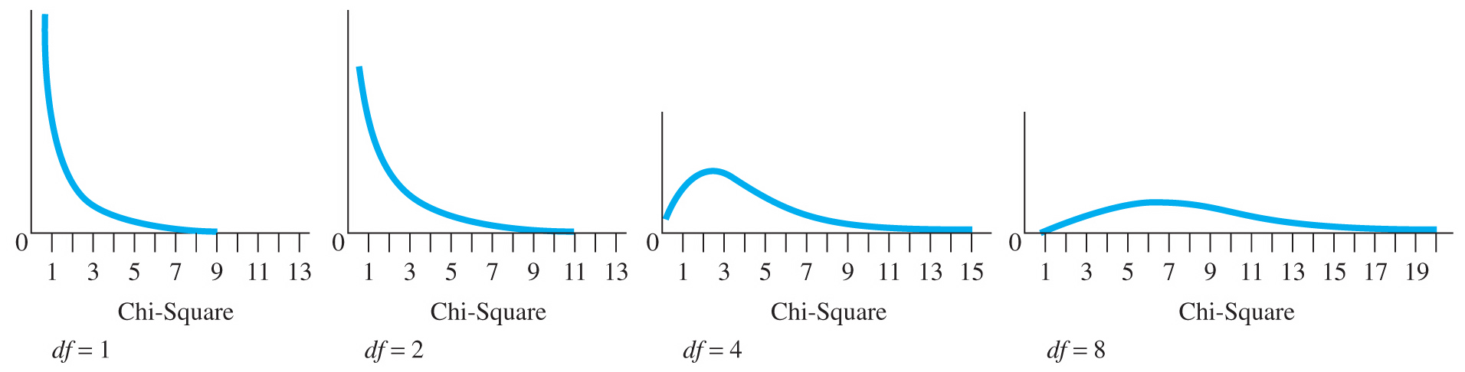
Chi-Square Statistic
Chi-square distribution
Unrelated to sample size, df is based on number of categories.
Copyright © 2009 Pearson Education, Inc. Upper Saddle River, NJ 07458. All rights reserved.

Slide 12
Logic of a Chi-Square
Non-significant: you expect all the frequencies to be equal to expected frequencies
Significant: you expect the observed frequency to be different from the expected frequency

Slide 13
Data Screening
Data is accurate
Observed frequency for each cell
You should have not many small frequency cells (i.e. < 5)
You should not have any zeroes
If these two conditions are not met, you should:
Use Fisher’s exact
Combine categories when you can
Get more data when you can

Slide 14
Get the Frequencies!
Let’s say you were given a big data set of the participants, rather than the raw numbers.
You can use pivot tables in excel to get the summaries.

Slide 15
Proportion Test
Direct link: http://vassarstats.net/propdiff_ind.html
Men were more likely (56%) than women (26%) to attribute their ACL injury as the primary reason they were no longer playing soccer (p=0.02). (31/55 male, 12/45 female)

Slide 16
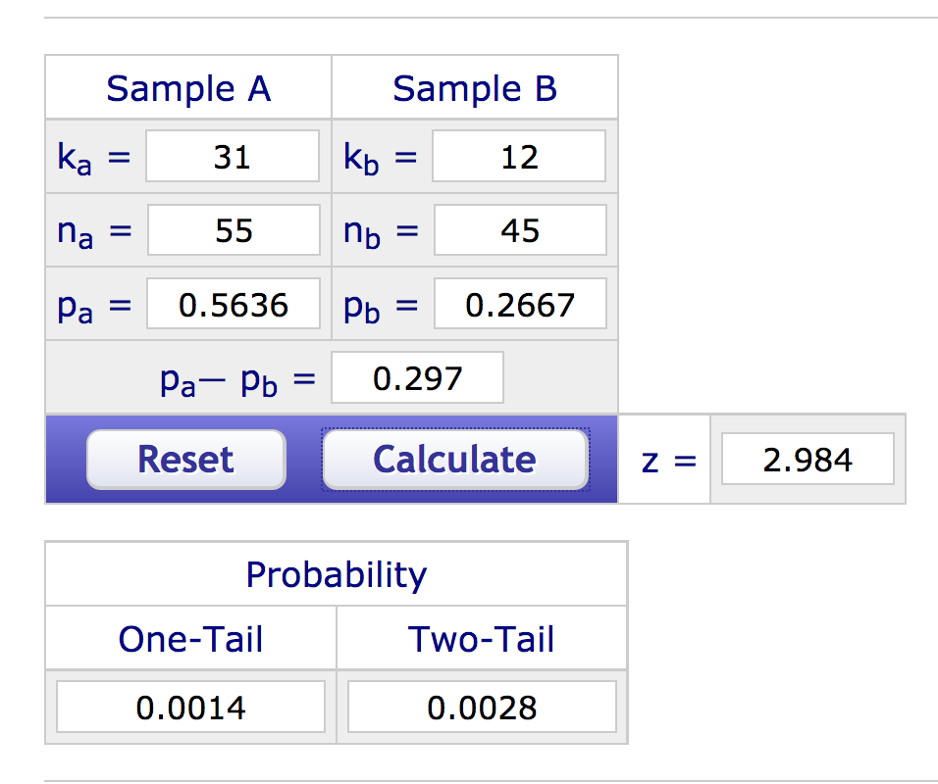
Proportion Test
z = 2.98, p = .003

Slide 17
Goodness of Fit
Direct link: http://vassarstats.net/csfit.html
Is there a difference in A grades for each of the same undergraduate statistics courses?
 | PSY 200 | SOC 302 | MTH 340
A grades | 25 | 18 | 11

Slide 18
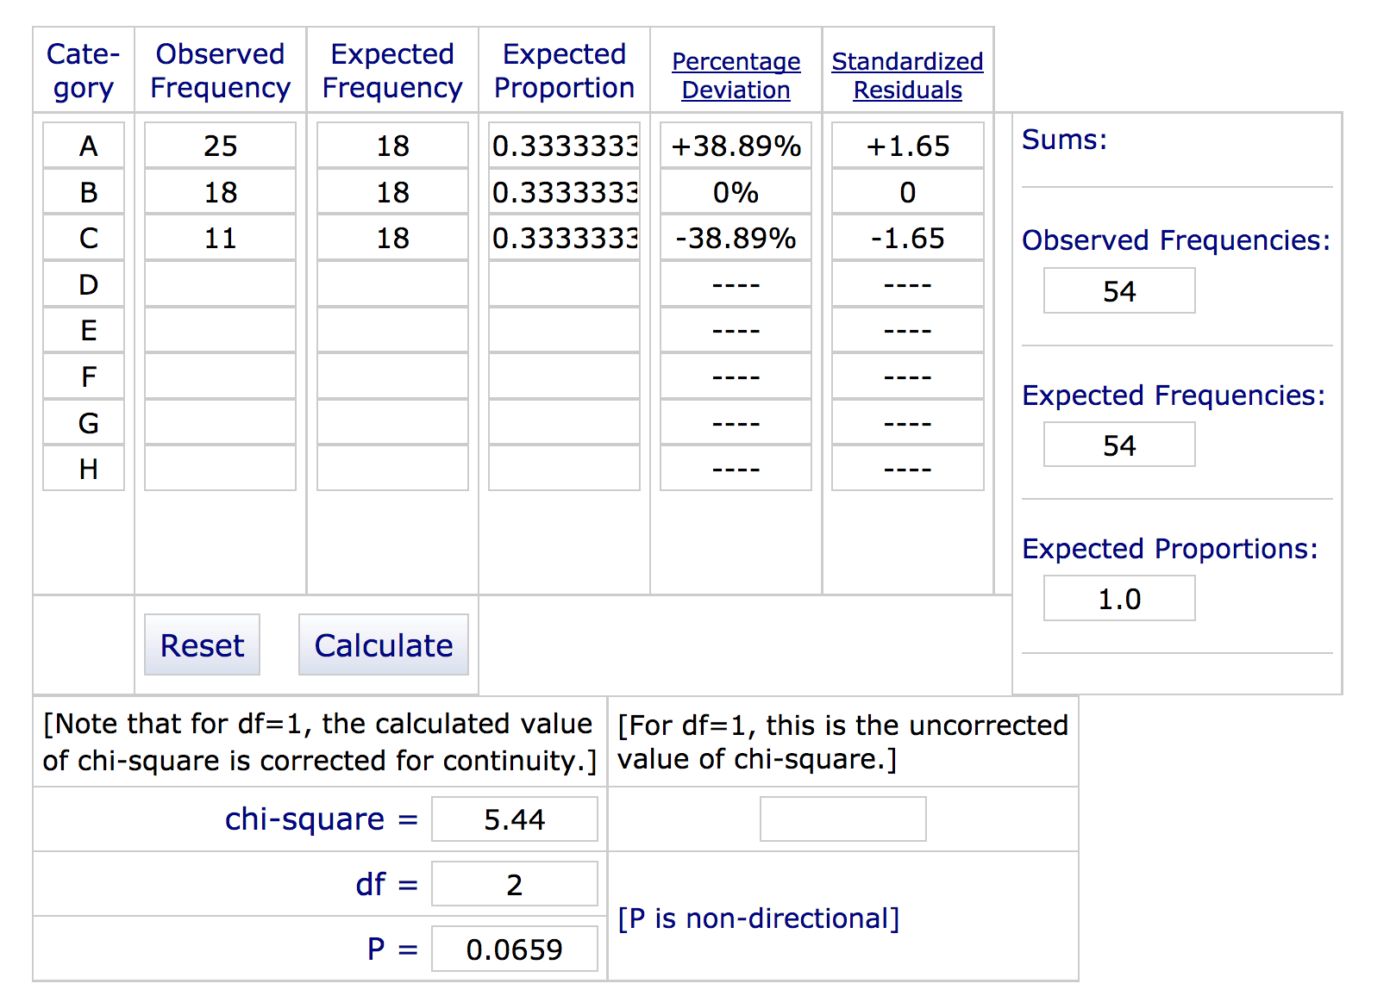
Goodness of Fit
𝝌²(2) = 5.44, p = .07
What would I do if it was significant?
Standardized residuals
df = number of categories - 1

Slide 19
Cramer’s V (phi)
The effect size for chi-square test for independence
df row/column = smaller number of (R-1) or (C-1)
(rows – 1) or (columns – 1)

Slide 20
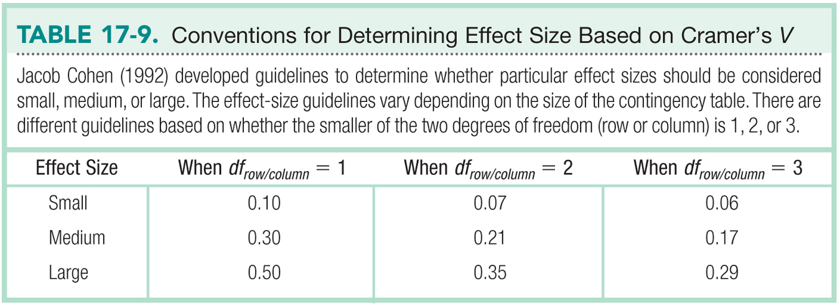

Slide 21
Independence Test
Direct link: http://vassarstats.net/newcs.html
Is there a pattern to the expected number of grades across professors?
 | A | B | C | ROW TOTALS
Prof 1 | 5 | 6 | 5 | 16
Prof 2 | 12 | 4 | 3 | 19
Prof 3 | 11 | 9 | 3 | 23
COLUMN TOTALS | 28 | 19 | 11 | N = 58

Slide 22
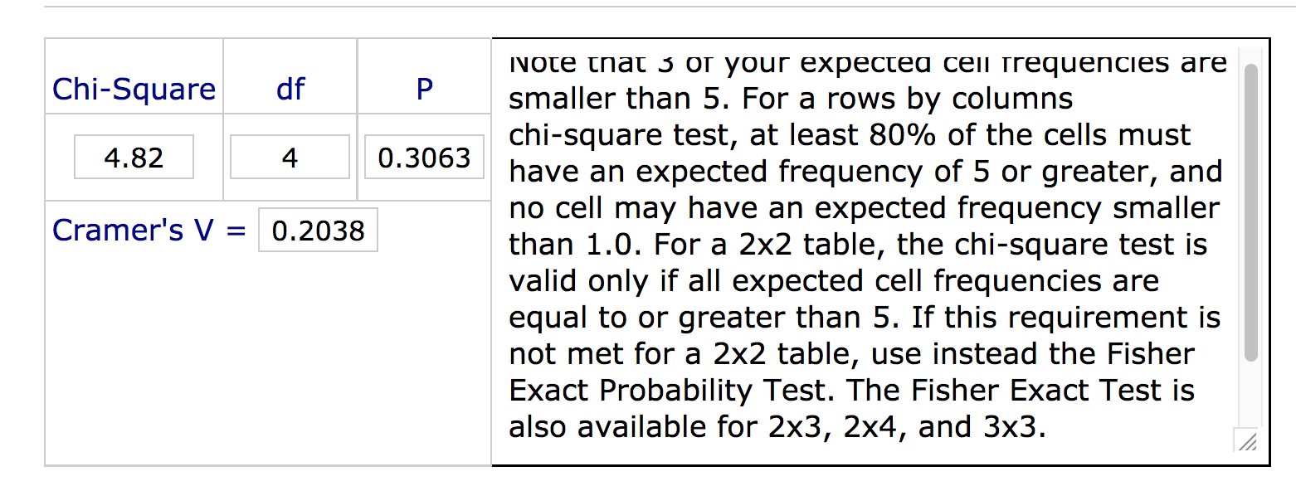
Independence Test
𝝌²(4) = 4.82, p = .31, V = 0.20
df = (rows – 1) * (columns – 1)

Slide 23
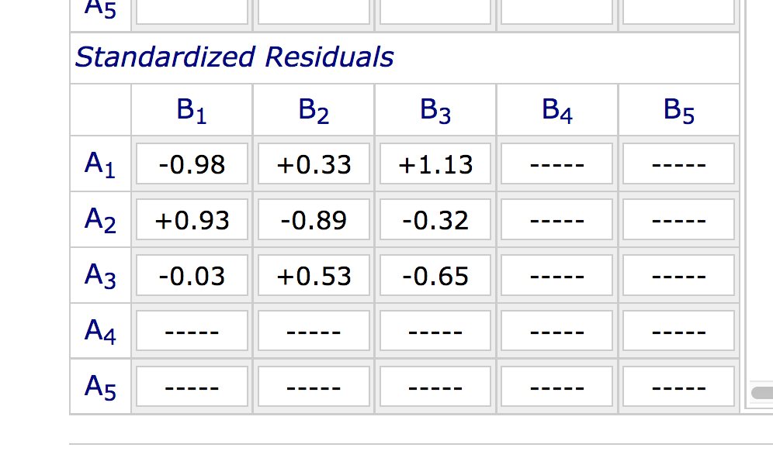
Independence Test
Standardized Residuals

Slide 24
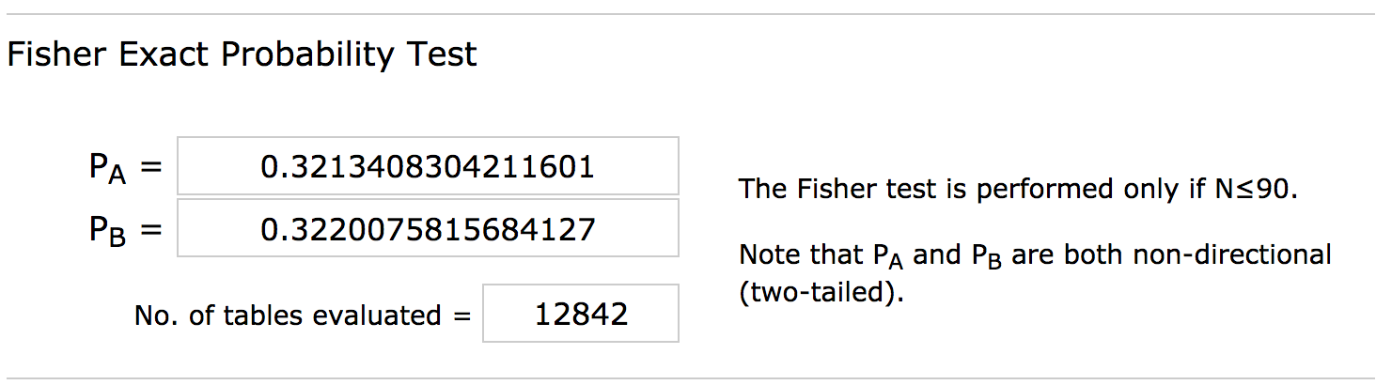
Fisher’s Exact
Direct(ish) link: http://vassarstats.net/vsfreq.html
Let’s test the same idea with Fisher’s Exact.
p = .32
Use P_{B}

Slide 25
McNemar’s Test
Direct link: http://vassarstats.net/propcorr.html
Is there significant change in yes/no ”scared” scores after an intervention about a medical procedure?
 | Post-Yes | Post-No
Pre-Yes | 15 (match) | 35
Pre-No | 4 | 40 (match)

Slide 26
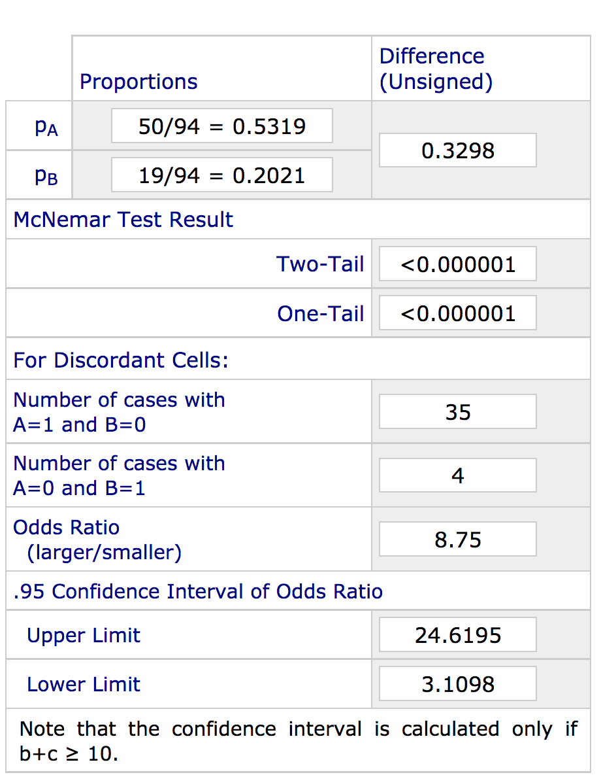
McNemar’s Test
p < .001
OR = 8.75

